Slide 1
Web Optimization
git@github.com:GTC-JS/ExtraPresentations.git

Slide 2
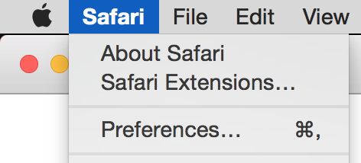
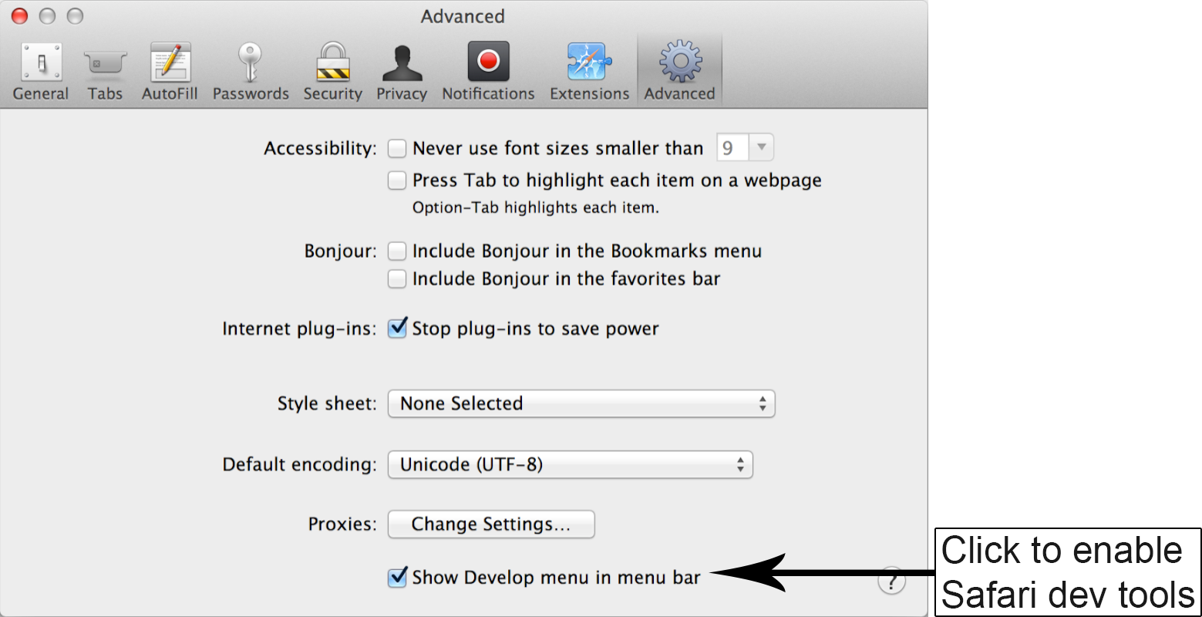
Enable Dev Tools on Safari

Slide 3
Developer Tools
Keyboard Shortcut
WIN: F12, or Ctrl + Shift + I
MAC: Cmd + Opt + I

Slide 4
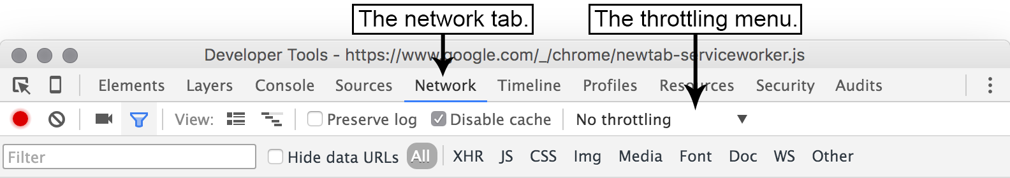
Simulate Network Conditions

Slide 5
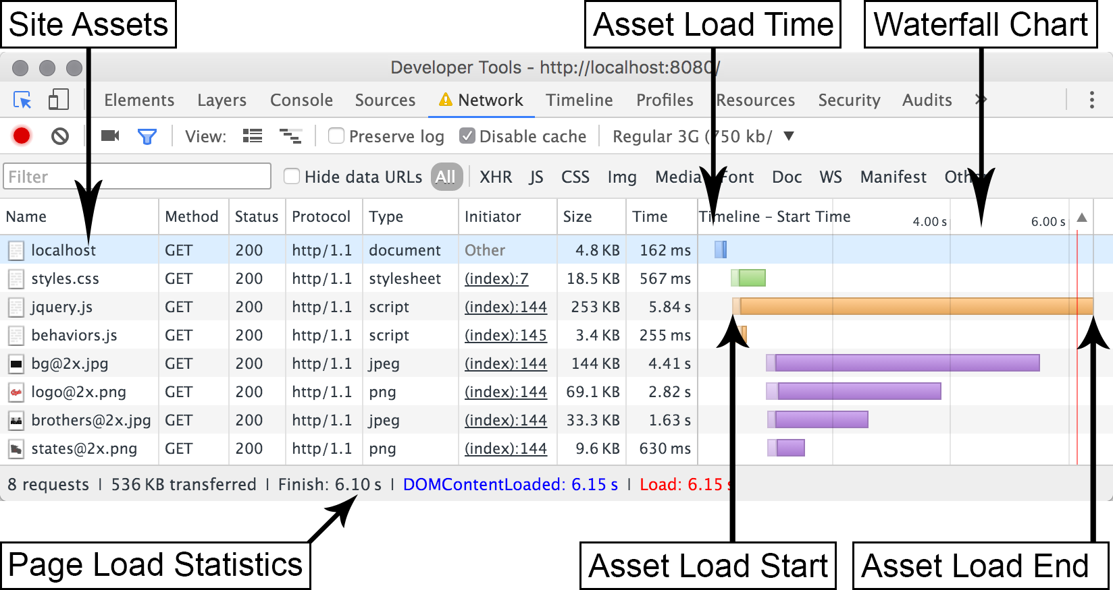
Waterfall Charts
Analyze amount of requests, size of website in kilobytes, time to load
Notes:
Safari network tab lacks waterfall graph. It shows a table with latency, start time and duration columns

Slide 6
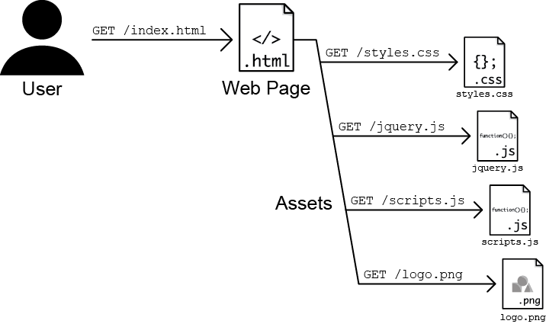
Asset Requests by Browser from Server
Notes:
As the web browser downloads the HTML, it discovers a <link> tag to a style sheet, a couple of <script> tags linking to some JavaScript files, and an <img> tag referring to an image.
Can be 100s of assets.

Slide 7
Node and Git
nodejs.org
Hosted npm packages listed on npmjs.com
> npm install express
installs the Express framework to your current directory, which we use to create a simple web server
git-scm.com/downloads
> git clone https://github.com/malchata/ch1-coyle.git
> cd ch1-coyle
End result: git checkout -f optimized
> node http.js
Visit http://localhost:8080/

Slide 8
Optimization Steps
Minifying the assets (CSS, JavaScript, HTML…)
Optimize the images preserving their visual integrity
Compression on the server for text assets

Slide 9
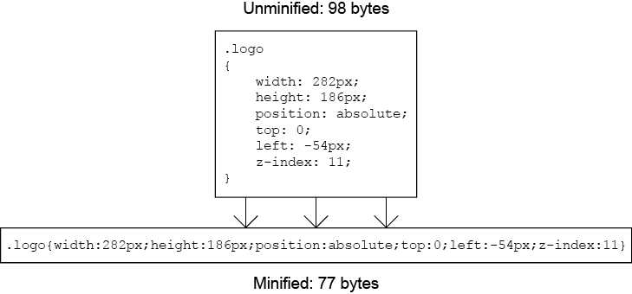
Minification
Strip all white space and characters not unnecessary for functionality

Slide 10
Minification tools
> npm install minifier –g # for js and css filed
> npm install html-minify –g # for html files
> cd css
> minify styles.css
Minification complete
> ls -la
18712 Jun 18 03:56 styles.css
16043 Jun 18 04:06 styles.min.css
> mv index.html index.src.html
> htmlminify index.src.html > index.html
Notes:
cd ../js
minify jquery.js
minify behaviors.js

Slide 11
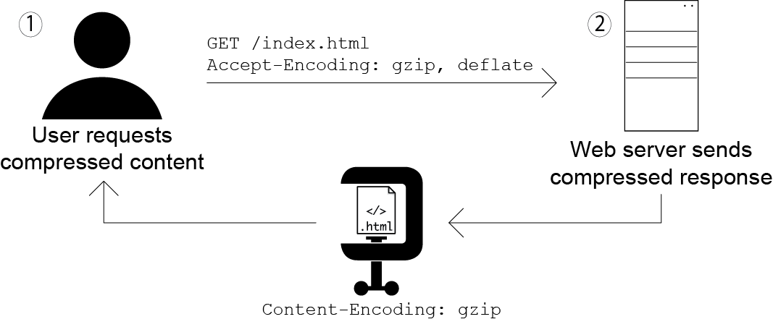
Compression

Slide 12
Adding compression
npm install compression
Edit http.js
Refer to library
var compression = require("compression");
Add it to your app on server
app.use(compression());

Slide 13
http.js changes
var express = require("express");
var compression = require("compression"); //imports module
var app = express();
// Run static server
app.use(compression()); //hooks compression module to web server
app.use(express.static(__dirname));
app.listen(8080);

Slide 14
Other Servers
For Apache, edit httpd.conf check if the module is available, enable on media/MIME types:
<IfModule mod_deflate.c>
AddOutputFilterByType DEFLATE text/html text/css text/javascript
</IfModule>
For IIS, use inetmgr GUI tool
Don’t enable compression on already compressed files
like JPEG, PNG, GIF images and WOFF/WOFF2 font files.
Notes:
These file types already use compression when they're encoded.

Slide 15
Image Compression
tinyPNG.com
Ch 6 mentions local tools
Checkout optimized branch and see new waterfall
git checkout -f optimized

Slide 16
Ch 2: Assesment Tools
git@github.com:GTC-JS/ExtraPresentations.git
- Google PageSpeed Insights
- Network request inspectors for timing information for assets
- Rendering profilers to diagnose poor rendering performance
- Benchmarking JavaScript code
- Emulating different device and internet connection

Slide 17
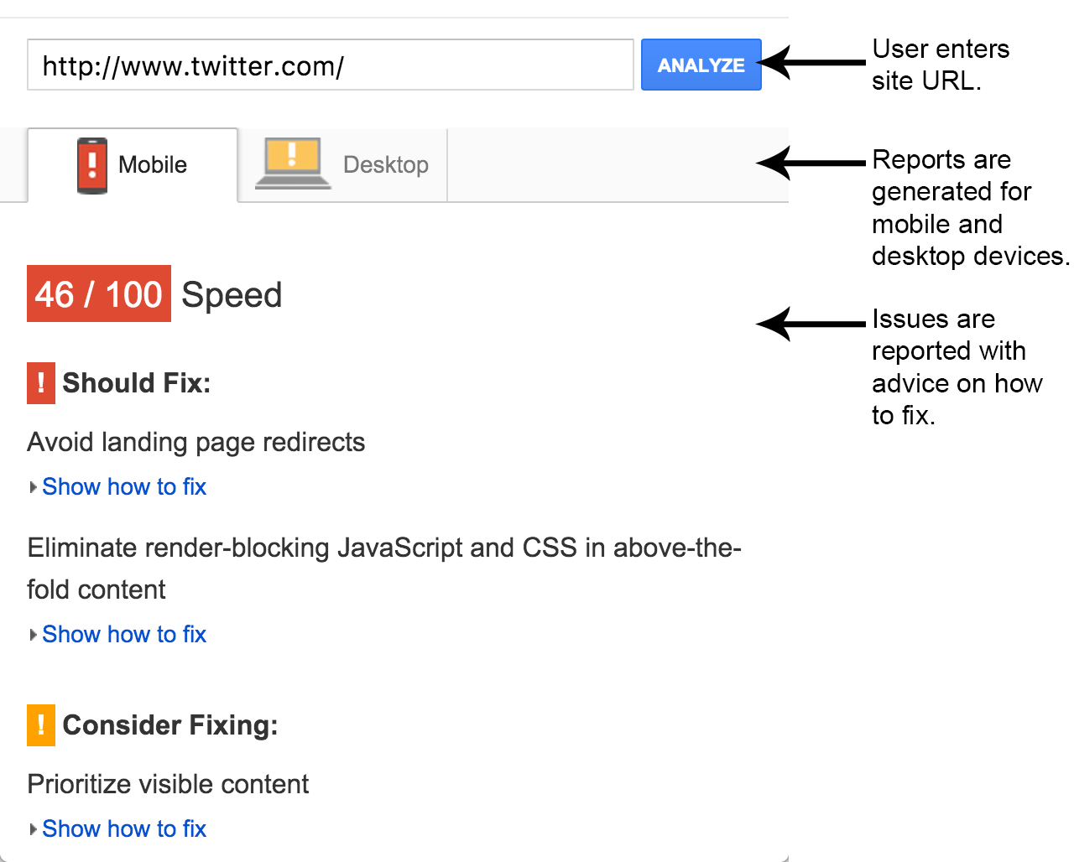
Google PageSpeed Insights
https://developers.google.com/speed/pagespeed/insights/
Notes:
compare
http://jlwagner.net/webopt/ch01-exercise-pre-optimization
http://jlwagner.net/webopt/ch01-exercise-post-optimization

Slide 18
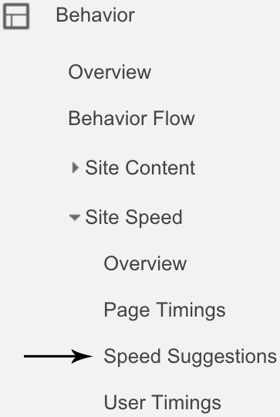
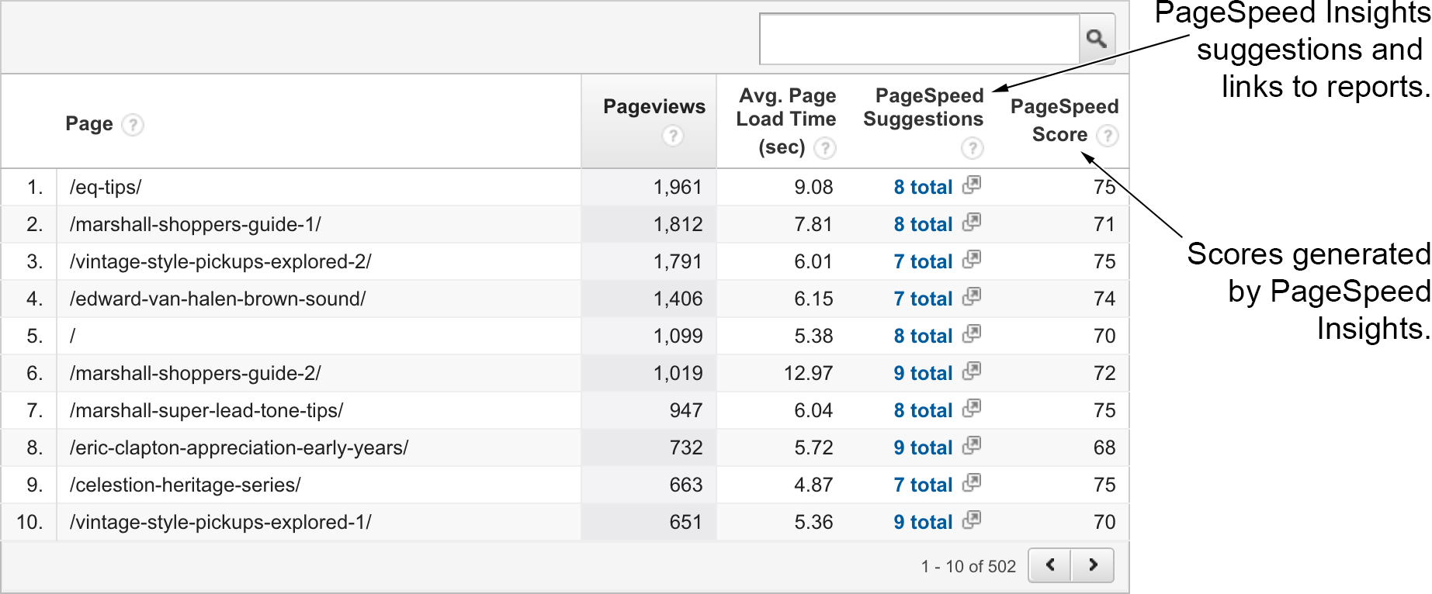
Accumalated Page Speed Insights from Google Analytics
http://www.google.com/analytics

Slide 19
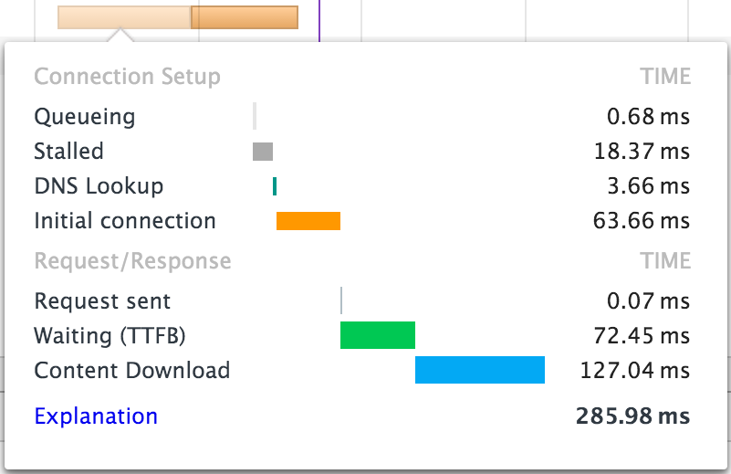
Dev Tools Network Tab
Waterfall Chart for each resource
TTFB: Time to First Byte

Slide 20
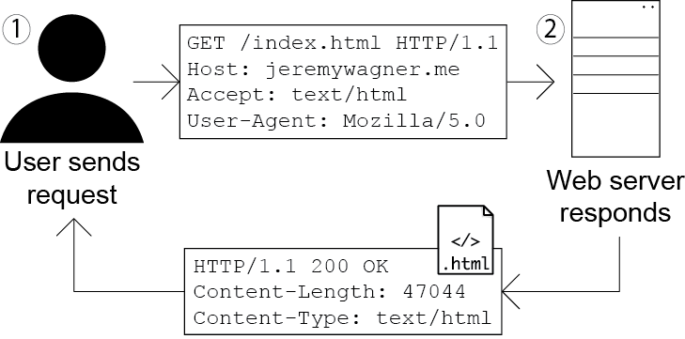
Headers

Slide 21
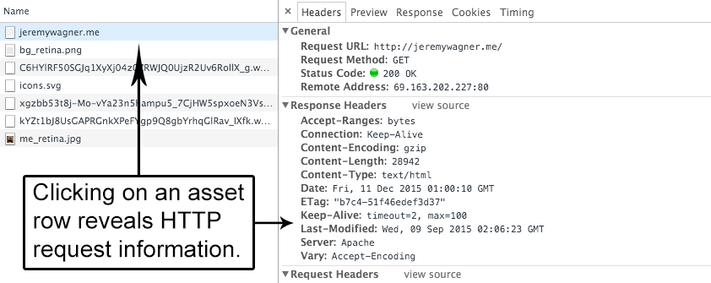
Viewing Headers

